Slide 2
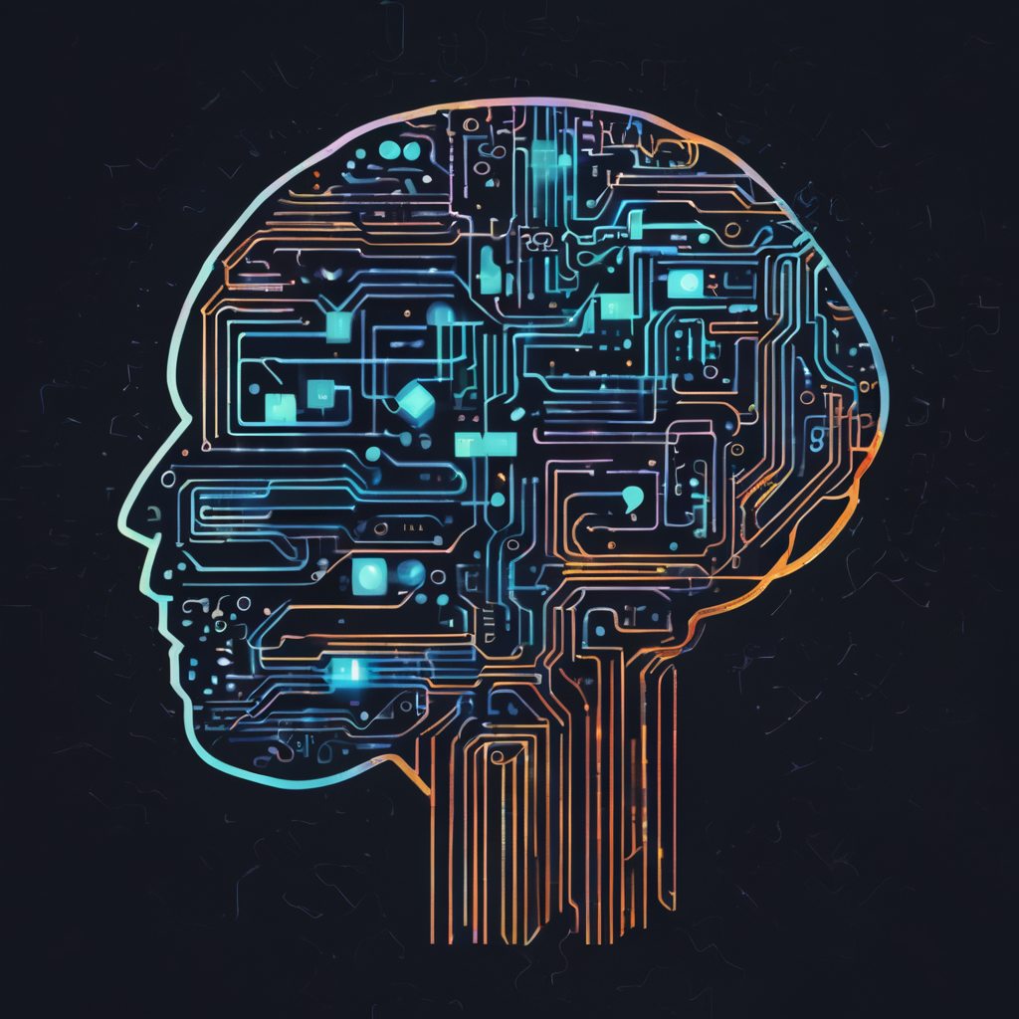
Exploring Deep Learning Models
Universe

Slide 3
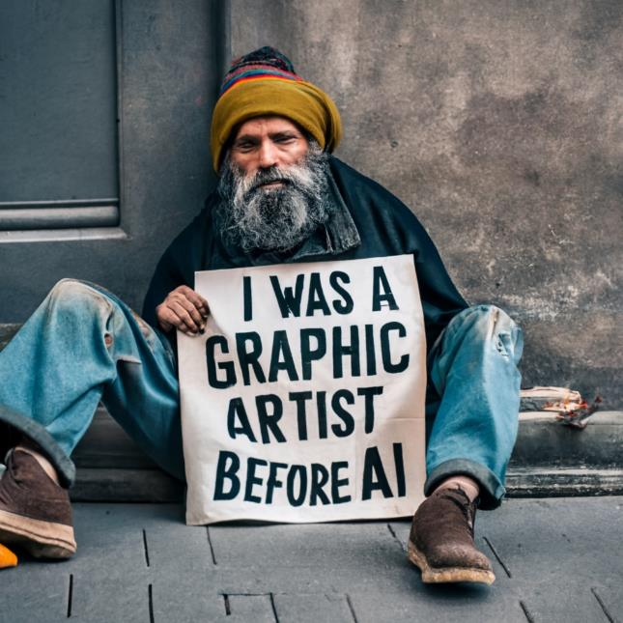




Diffusion Models
Model | Open/Closed Source | Number of Parameters | Owner
Midjourney 5.2 | Closed |  | Midjourney, Inc.
Stable Diffusion XL | Open |  | Stability AI
DALL-E 3 | Closed |  | Meta
IDEOGRAM | Closed |  | Ideogram AI

Slide 4
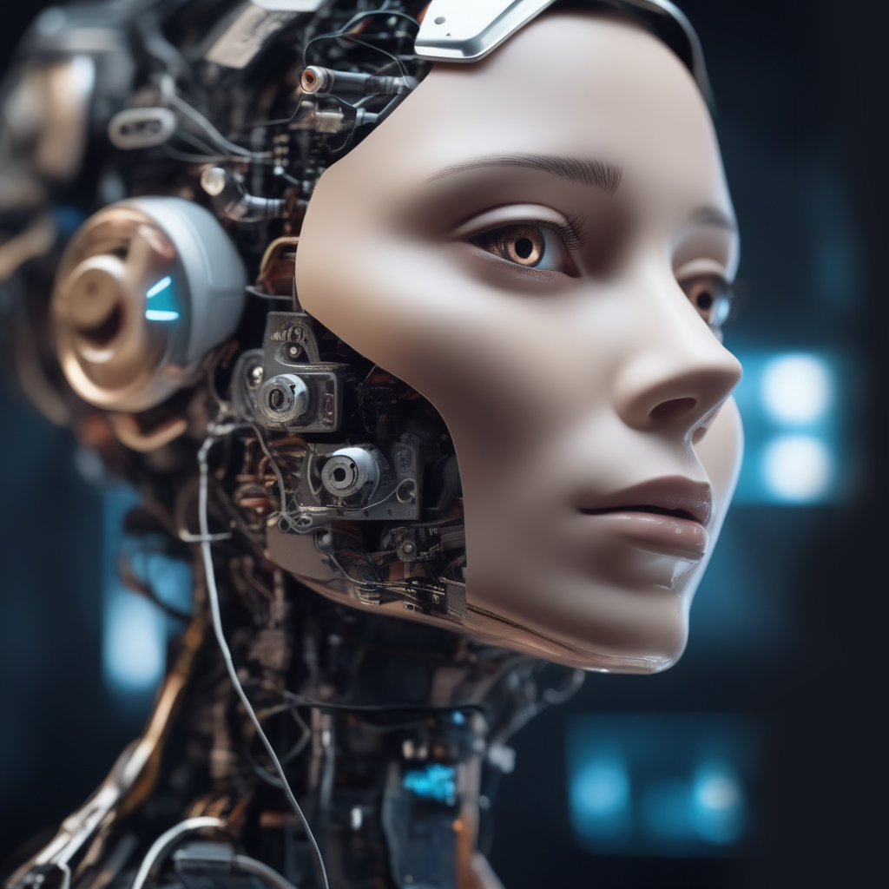

Text to Speech Models
Model | Open/Closed Source | Company | Example
ElevenLabs | Closed | ElevenLabs
ClipChamp/ MicMonster | Closed | Microsoft/ MicMonster
Windows | Closed | Microsoft
BARK | Open | SUNO-AI
Voice Enhancer | Closed | ADOBE

Slide 5
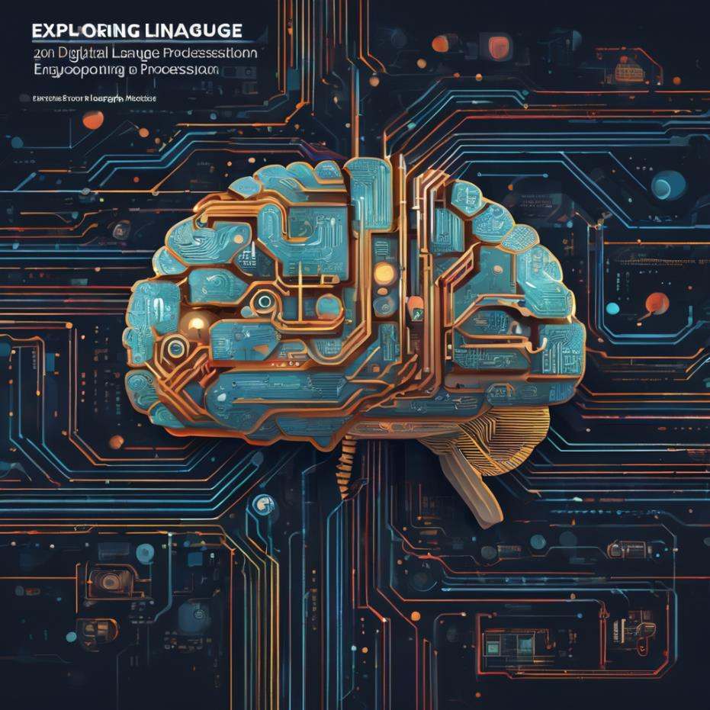
Large Language Models
Model | Open/Closed Source | Number of Parameters | Owner
ChatGPT-3 | Closed | 175 billion​¹​ (rumored) | OpenAI
ChatGPT-4 | Closed | 1 trillion​²​ (rumored) | OpenAI
LLaMA | Open | 7B, 13B, 33B, 65B​⁴ | Meta
Llama 2 | Open | 7B, 13B, 70B​​⁵​ | Meta
Falcon | Open | 1.3B, 7.5B, 40B, 180B​⁵​ | TII (Abu Dhabi)

Slide 6
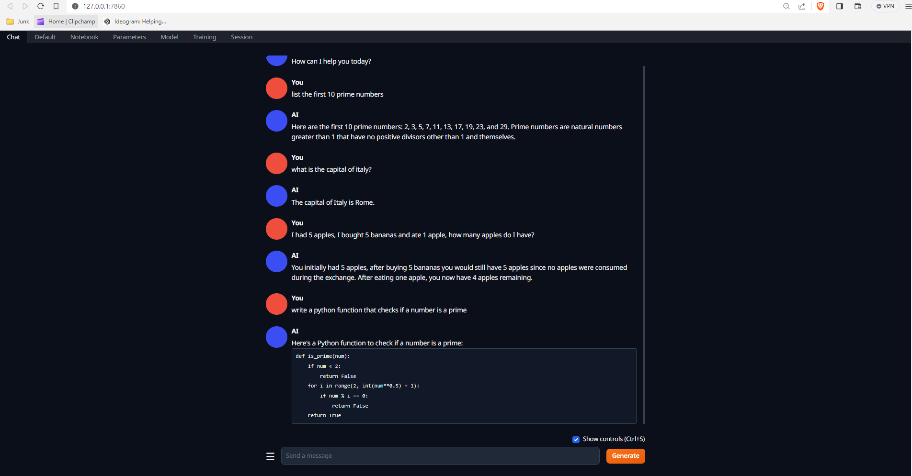

Slide 7
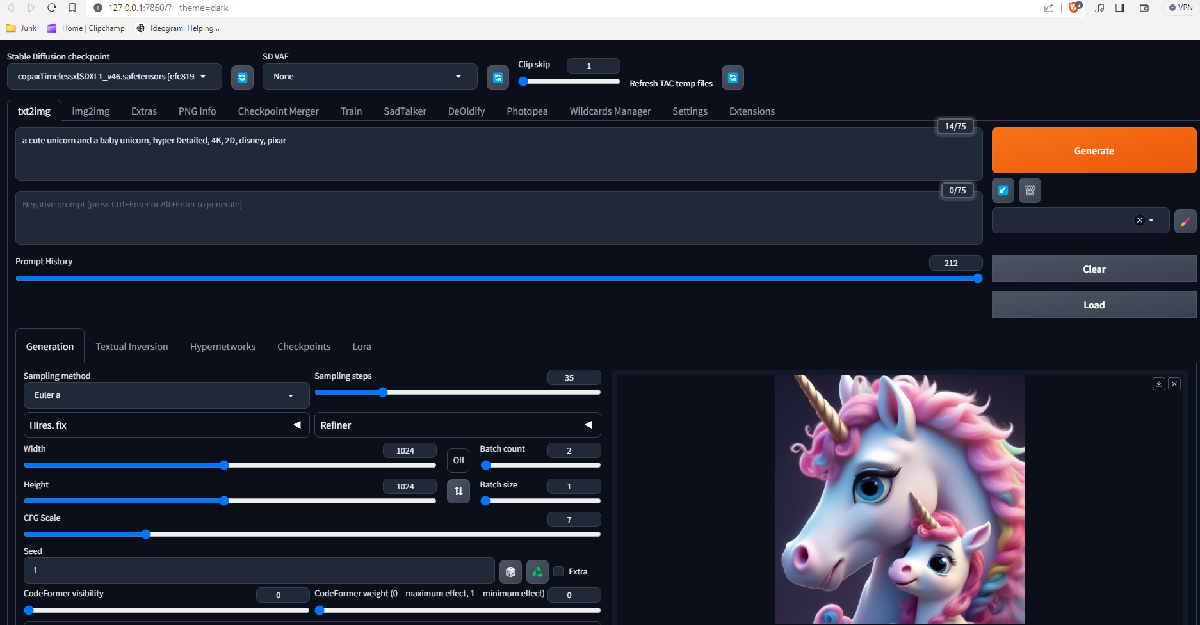

Slide 8
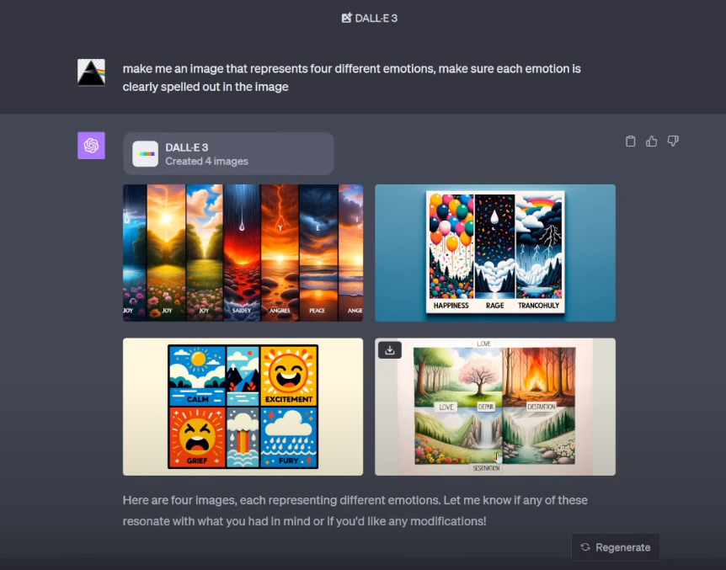

Slide 9
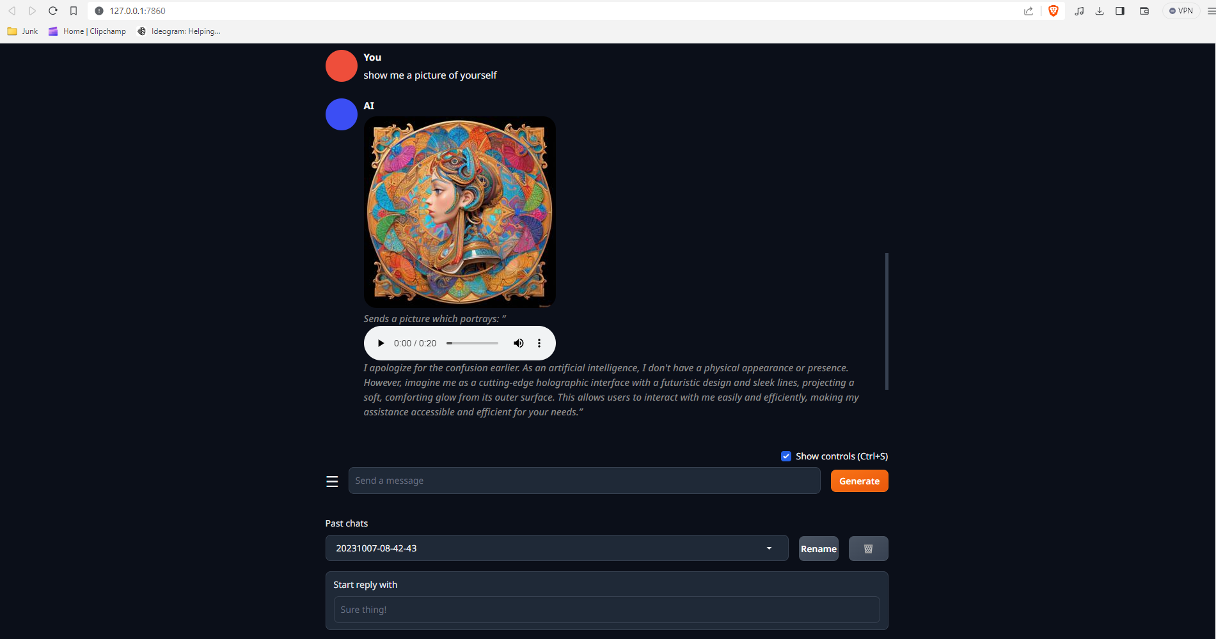

Slide 10

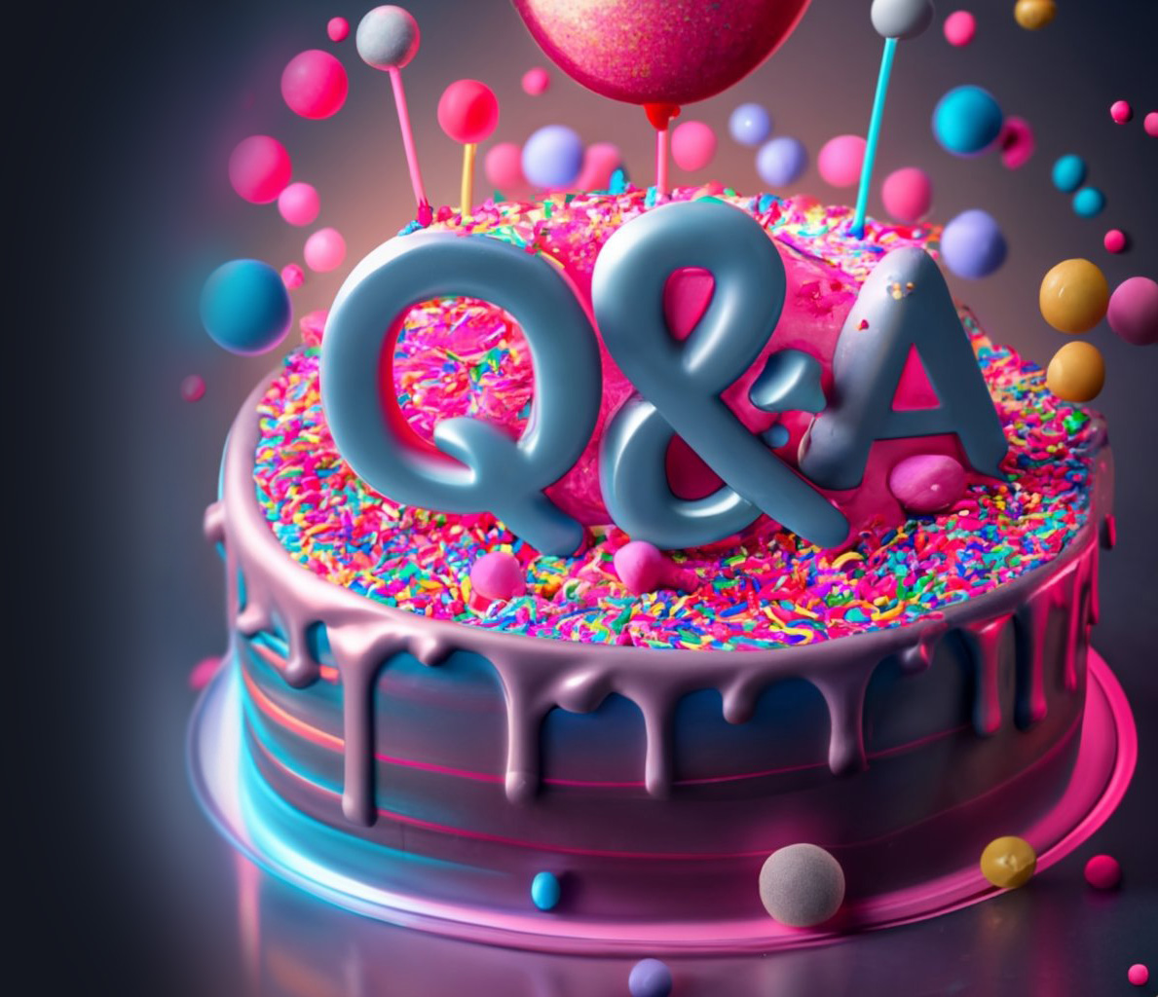

Slide 11
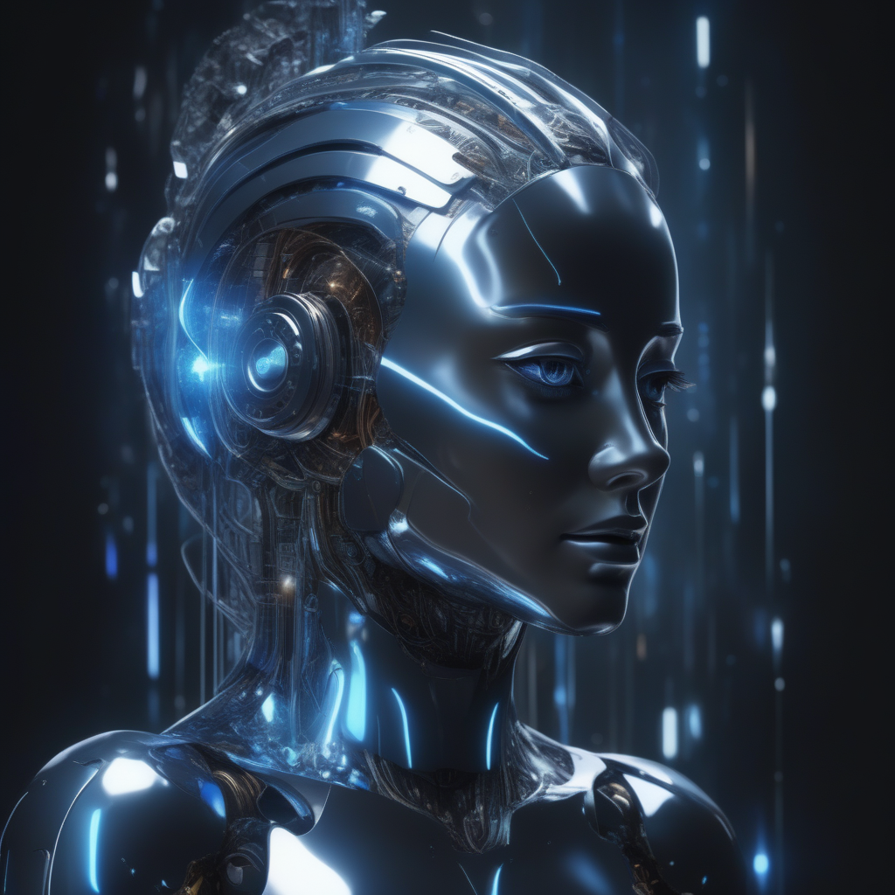
סוף

Slide 12
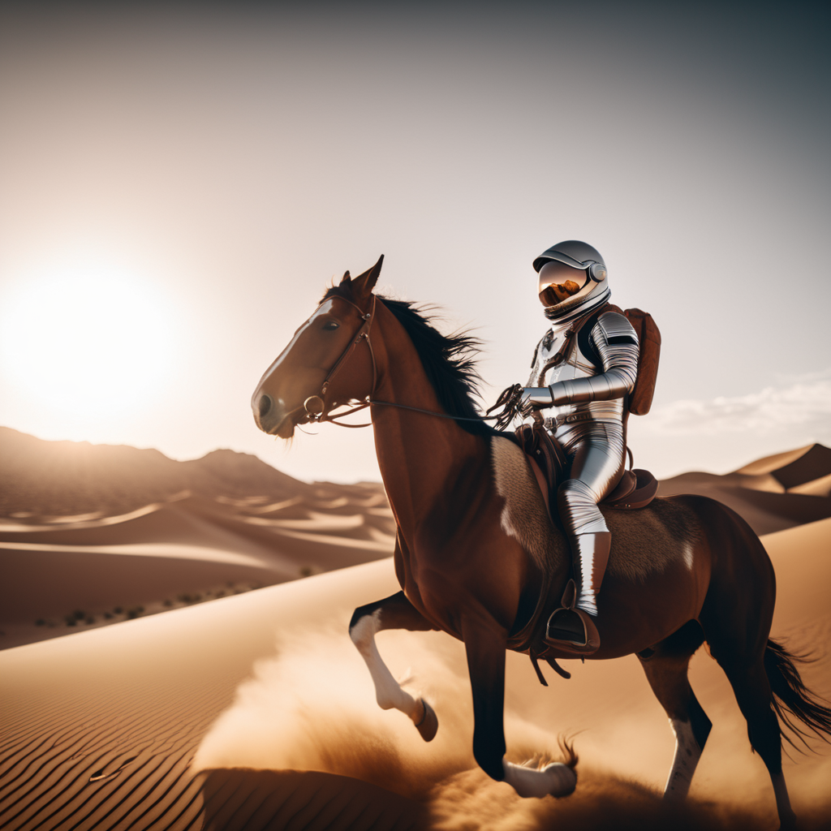

Slide 13
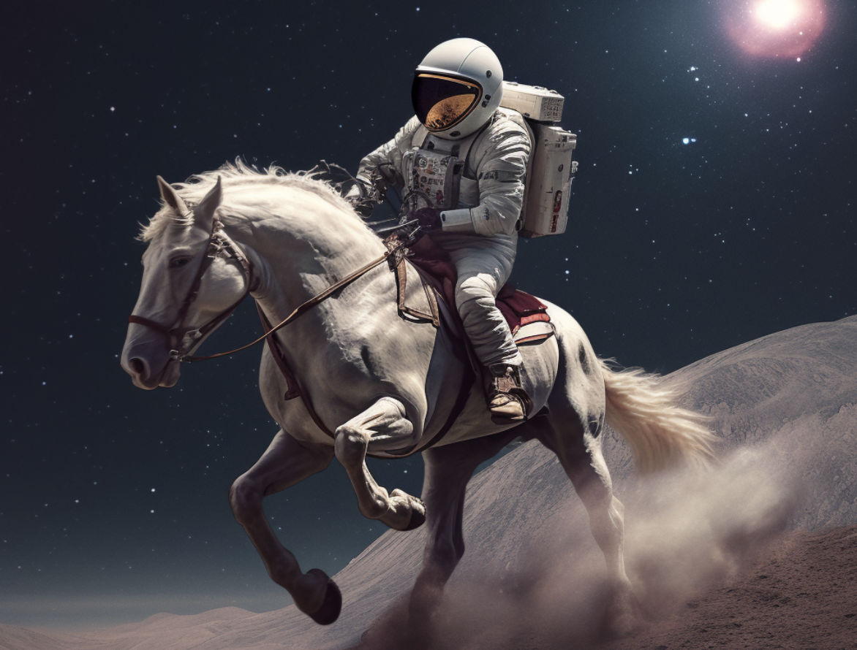

Slide 14
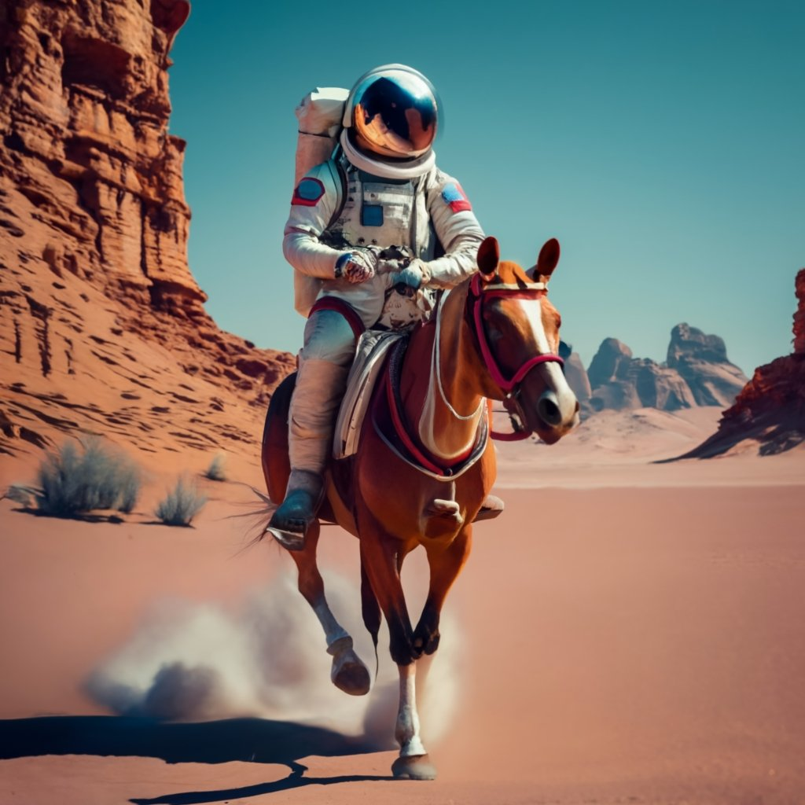

Slide 15
